Slide 1
We encourage parents to view this PowerPoint as you are listening to the Videos which are also stored in the Parent Portal.
The videos are best viewed/ heard while wearing headphones for sound quality purposes.
Please open and view the video:
Yr 6 Contemporary Learning Part 1

Slide 2
Year 6 Contemporary Learning Sneak Peek
A glimpse into ‘How we do what we do’ in Year 6 and Why it is so important for our children

Slide 3
What stands out for you when you read this quote?
“A lot of things we thought were important in school are actually not…… Unless things significantly shift in education we are not going to be able to solve those big hairy audacious problems that our children are going to have to face.” – Stephanie McConnell
Year 6 Contemporary Learning Sneak Peek

Slide 4
Five key take away’s from the College’s 2021 Community Forum
What are the qualities we are seeking of a Prince of Peace Graduate?

Slide 6
Activity: Connect Extend Challenge
Watch the following Clip ‘The Adaptable Mind’.
https://www.youtube.com/watch?v=937iCwJd3fI
After viewing, on a piece of paper, write down a thought for each of the following points.
One thing that you connected strongly with because you agree with it and it confirmed an idea that you already held…
One thing that extended your thinking in some way. A new idea that extended or broadened your thinking…
One thing that challenged your thinking and brought up new questions for you…

Slide 7
Please now open and view the video:
Yr 6 Contemporary Learning Part 2

Slide 8
What do Contemporary Flexible and Collaborative Spaces provide us with?
The ability to:
Develop the essential skills of the future (Empathy, Curiosity, Creativity, Multi-Disciplinary Learning, Initiative)
Allow for movement
Allow for various groupings
Allow for hands on exploring, making and building
Support social interaction and development
Support cognitive skills and development
Support the integration of technology
More interaction and feedback with the teachers
Allow for collaboration
Allow for ease of movement with furniture
Allow for student voice and choice in their learning - AGENCY
Allow for self-regulation and space

Slide 9
What has happened so far this year in Year 6
Students utilising the outdoor spaces to work together on group projects
Students meeting together in classrooms during lunch breaks to complete assessments
Students working across the classes to collaborate on assignments

Slide 10
What has happened so far this year in Year 6?
Students moving to different classrooms for different subjects
Students meeting in one classroom for devotions or meeting times
Students collaborating and working together in the Library space for Christian Studies and Spelling

Slide 11
Exciting News
The Year 6 team are delighted to let you know that in 2022 and beyond, their collaborative learning space will be in the Resource Centre.

Slide 12
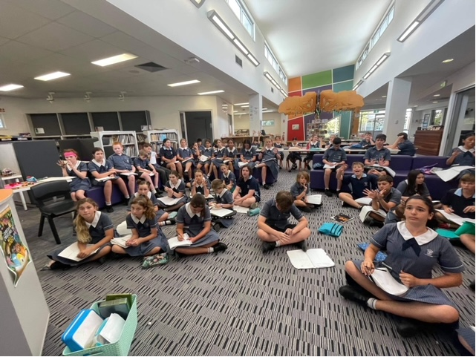
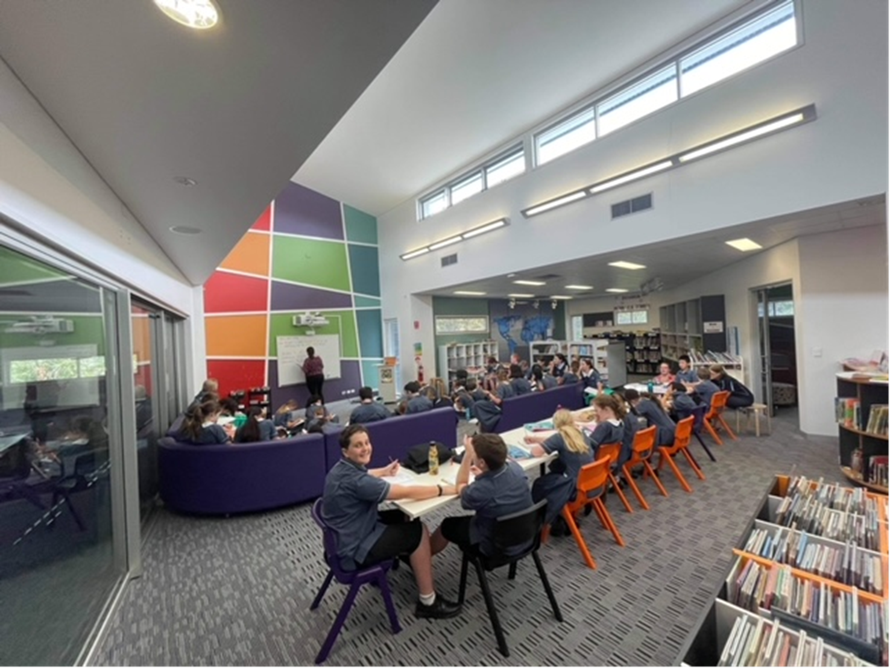

Slide 13
What do the students think?
I think that year 6 is run really well, I like how we spend lots of time focusing on what Year 7 will be like and moving to different classrooms with different teachers. That has made year 6 stand out from all the other grades and that is why year 6 has been my favourite year (as well as having an awesome teacher).

Slide 14
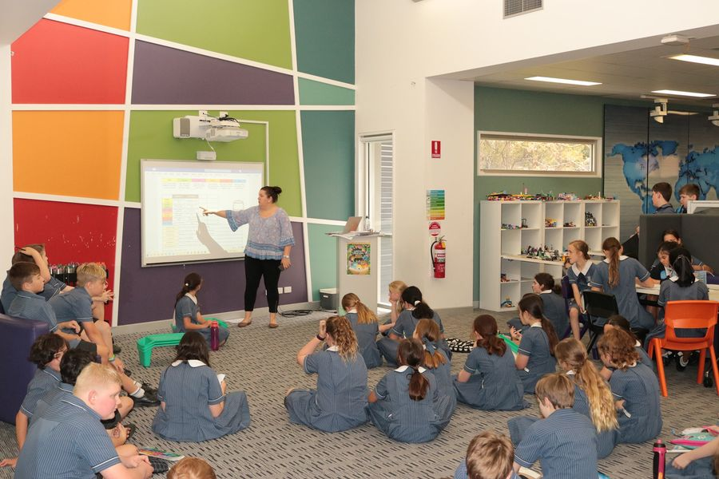

Slide 15
What do the students think?
I liked that we had a lot of joint work with the whole of year 6. I have enjoyed year 6 at POP, I liked having two teachers, and changing classrooms for different lessons that was fun.
I think year 6 is run in a very good way. We get to see our different teachers and we get to learn different subjects that different teachers excel at. I have really enjoyed myself in Year 6.

Slide 16
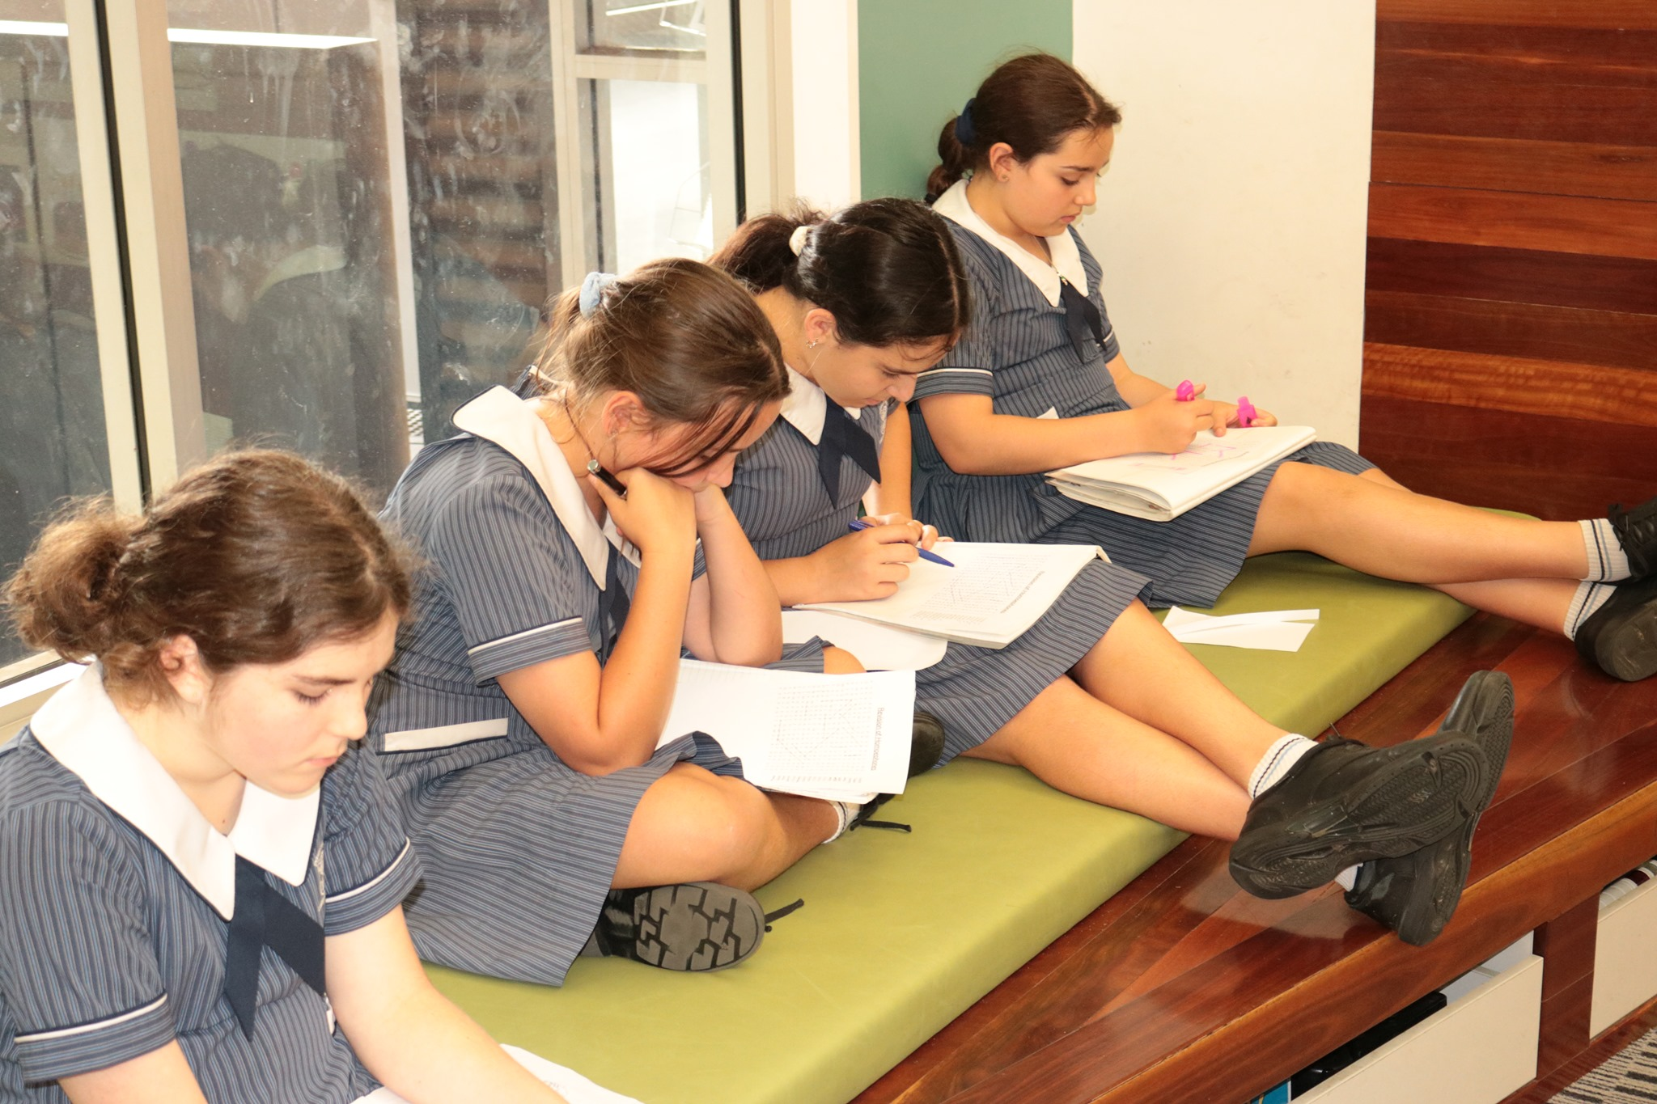

Slide 17
What do our current Year 6 students think?

Slide 18
What do the students think?
I really enjoy how Year Six is run - all the group work, character building activities, hands on work, and especially the different subject held by different teachers - a really good way to prepare for Senior school.
I really like spending time with all the teachers, its nice to see them not just at break times.
I like how instead of having one teacher you have many when we are doing spelling together. It's nice to have different people from different classes and work with them.

Slide 19
What do the students think?
I think its the best year to get ready for high school and it's fun and I couldn't have a more positive experience. I love how teachers are passionate about their subject and I like having different teachers to gain different ideas or tricks for my learning.
I loved having opportunities to learn with the entire year 6 cohort (except when we were squished into a small classroom). It was cool to know we were all learning the same thing at the same time.

Slide 20
Bonus Bits ☺
Getting to see collaboration in action (teachers)
Teachers being an ‘expert’ in their area of passion
Students learning from teachers who are teaching their passion area
Access to collaborative spaces
Ability to differentiate
Time efficient for students – not having to go in and out of classrooms
Ease of access to all teaching staff
Transferable soft skills – Creativity, Curiosity, Initiative, Multi-Disciplinary Learning, Empathy
Relationships between students
Being able to address issues immediately
Building relationships with a variety of teachers

Slide 21
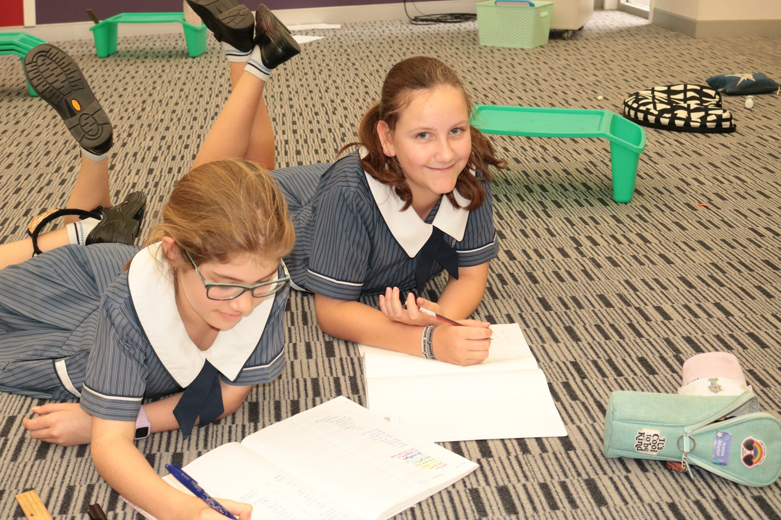
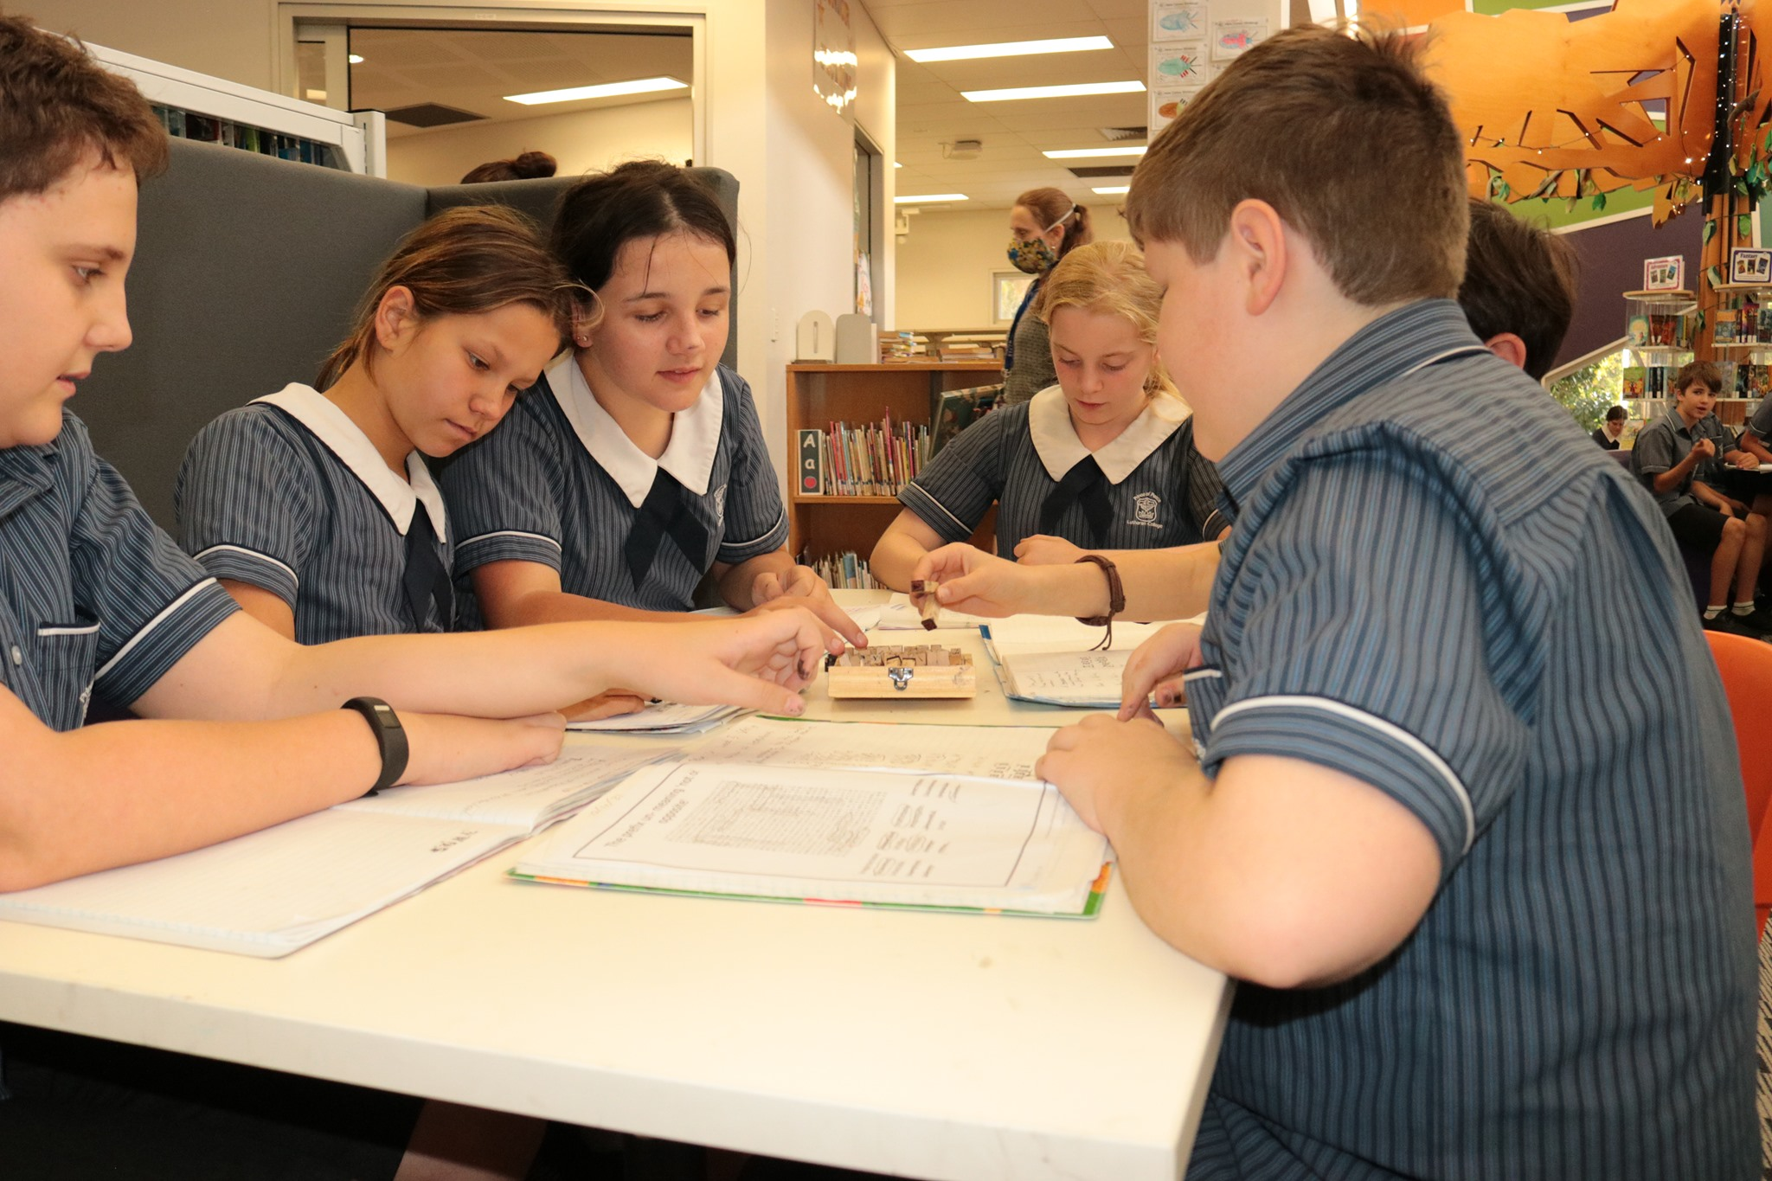

Slide 22
Some questions from our evening?

Slide 23
Questions?
Will my child still have their own teacher?
Yes, students will still have their own Pastoral Care teacher. They will still have that one teacher that they can call their own, but they will have the opportunity to go to and speak with any of the Year 6 team to seek help. They will spend time together as a class and also as a cohort (all Year 6 students). Together they will develop a sense of class community and identity as well as cohort identity.
Classes will continue to spend periods of time both inside and outside, as we know this provides them with opportunities to reset, refresh and reconnect.

Slide 24
Questions?
Who will I Direct Message if I have a concern?
You will continue to message your child’s classroom teacher just as you always have.
As the Year 6 teachers are a tight unit, they will pass any concerns through to each other as needed. Together they plan, teach, facilitate and address all student and parent needs.

Slide 25
Questions?
Will my child have work differentiated?
100% yes! In fact, our staff report that their ability to differentiate and meet the needs of their students is easier in a contemporary learning space. Students who prefer a set seat, or routine location for learning can continue to have this. Students who prefer to have choice in their learning preferences can also have this. There are easily accessible zones for regulation available, quiet zones, individual zones, collaboration zones and much, much more.

Slide 26
Questions?
Will it be noisy?
Surprisingly no. Our staff tell us that student engagement in learning is significantly higher when students can bounce ideas off each other and problem solve together.
We often talk about the ‘hum’ of a classroom. This means that there should always be discussion, dialogue, deep listening and great swells of empathy. Students tell us that they feel more successful, valued in the process and engaged when they are able to have choice and contribute to their learning and the learning of others.

Slide 27
Questions?
I love the idea of my child learning this way, however, will the transition to high school be even harder if the high school they go to is not teaching in the same way?
The Junior Campus has been teaching in this way across multiple year levels for over 5 years. Starting in Year 3, our students are taught independence and self awareness as a learner. They are given choice in how they learn and are invited into helping construct their learning journeys. By Year 6 they are begging for us to take the ‘lid off’ them and let them fly. They want to fly and apply the skills they have been learning into a much more real world context.
What we love about contemporary educational transformation is that the skills we are working on: Curiosity, Creativity, Initiative, Multi-disciplinary Learning and Empathy are transferrable in to all contexts, and all high school settings.
What we are super excited about is that our Year 7 team, and Year 7 coordinator, are here with us tonight to learn and seek to apply these principles further into our Middle School. Our new Head of Senior Campus also has 13 years of experience as the Head of Middle School and has implemented some of these practices into her previous school too. Exciting times for sure.

Slide 28
Questions?
Any other questions?
If you have any other questions regarding ‘How our Year 6 team do what they do’, you are welcome to email:
Mrs Rebekah Bruyn – Learning Coach/ Year 6 Teacher
rbruyn@princeofpeace.qld.edu.au
Mrs Anne-Marie Schmidt – Deputy Head of Campus
aschmidt@princeofpeace.qld.edu.au
Mrs Katrina Valencia – Head of Campus
kvalencia@princeofpeace.qld.edu.au

